Slide 1
21CS644 – Data Science and Visualization
Module 2
Doing Data Science, Cathy O’Neil and Rachel Schutt, O'Reilly Media, Inc O'Reilly Media,Inc, 2013

Slide 2
Basic tools (plots, graphs and summary statistics) of EDA
The basic tools of EDA are plots, graphs and summary statistics.
Generally speaking, it’s a method of systematically going through the data, plotting distributions of all variables (using box plots), plotting time series of data, transforming variables, looking at all pairwise relationships between variables using scatterplot matrices, and generating summary statistics for all of them.

Slide 3
Philosophy of Exploratory Data Analysis
Emphasizes understanding data before formal modeling.
Focuses on visualizing and summarizing data patterns.
Aims to uncover relationships and insights.
Prioritizes hypothesis generation over hypothesis testing.
Iterative process of discovery and refinement.
Utilizes statistical tools for data exploration.
Facilitates decision-making through data-driven insights.
Encourages creativity in data interpretation.
Fundamental step in the data science workflow.

Slide 4
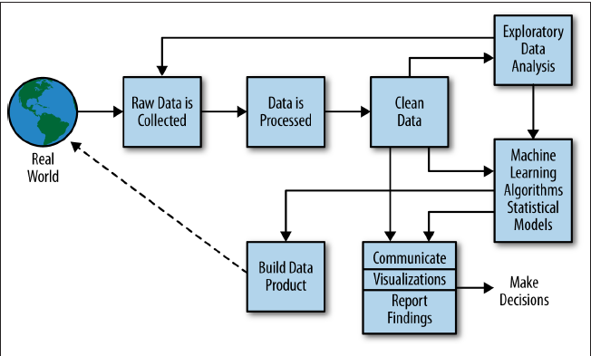
The Data Science Process

Slide 5
Case Study: RealDirect
RealDirect: NYC-based real estate platform disrupting traditional brokerage model.
Offers transparent pricing and reduced commission fees.
Utilizes technology for efficient property transactions.
Provides data-driven insights for buyers and sellers.
Employs licensed agents for personalized service.
Focuses on customer satisfaction and trust.
Facilitates direct communication between buyers and sellers.
Streamlines property search and transaction process.
Challenges traditional real estate industry norms.

Slide 6
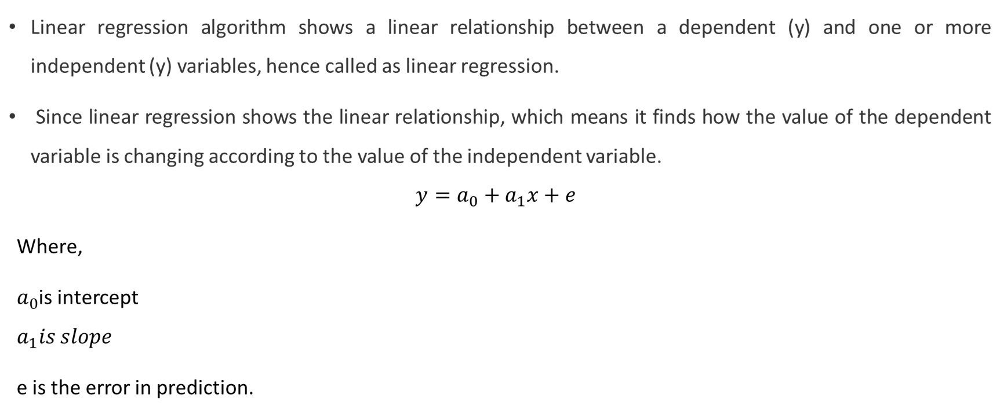
Three Basic Machine Learning Algorithms
Linear Regression

Slide 7
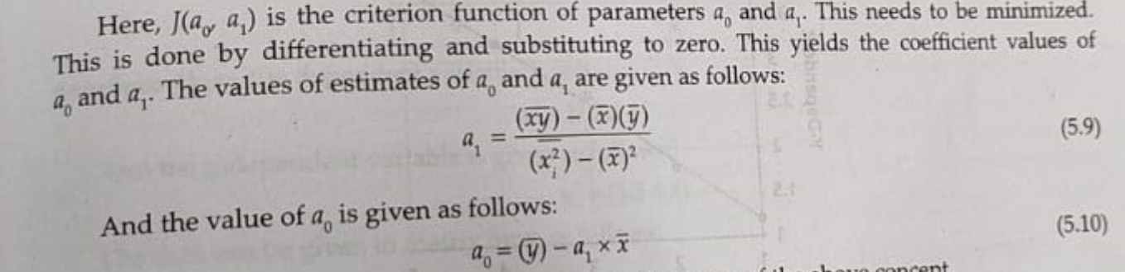

Slide 8
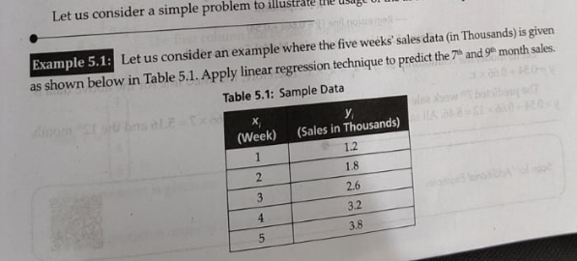

Slide 9
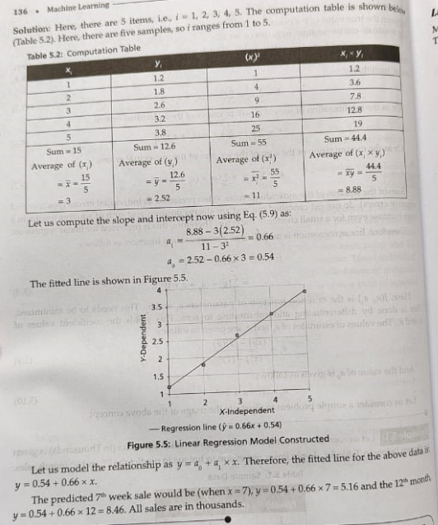

Slide 10
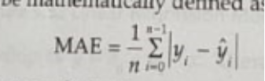
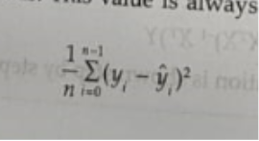
Validation of Regression Methods
Standard Error
Mean Absolute Error:
Where,
y’ is predicted output
Mean Squarred Error:

Slide 11

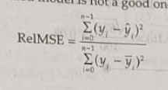
Root Mean Squared Error
Relative MSE

Slide 12

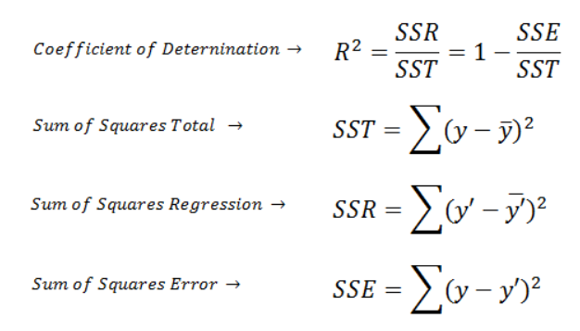
Coefficient of Variation
Coefficient of Determination

Slide 13
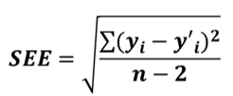
Standard Error Estimate

